Slide 1

Engineering a Content Delivery Network
Bruce Maggs
COMPSCI 512
Distributed Systems

Slide 2
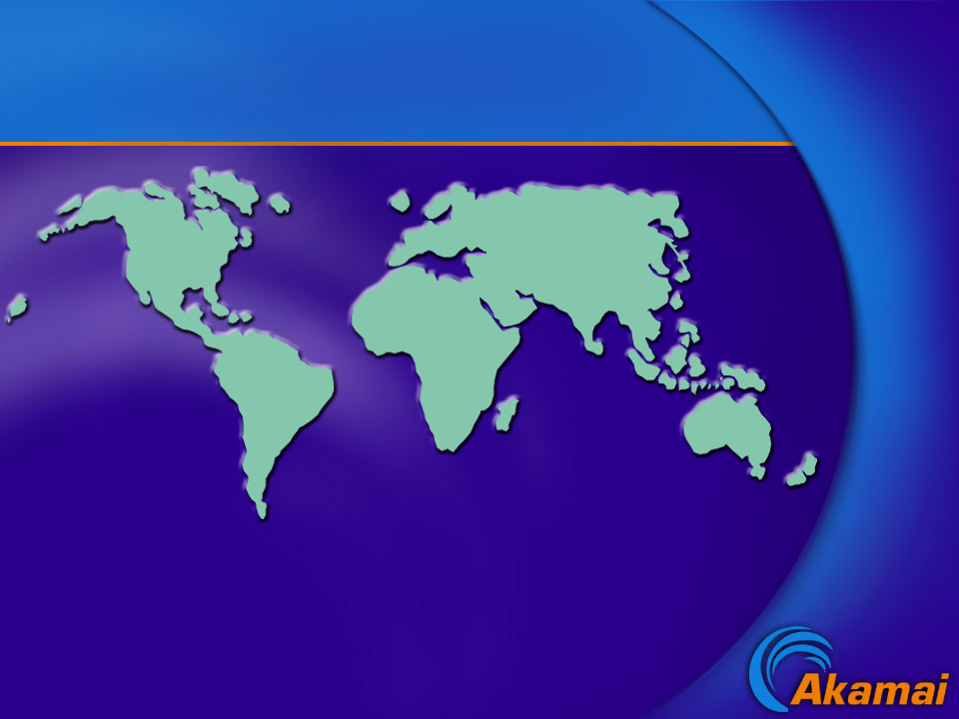

Network Deployment
160000+
Servers
1200+
Networks
95+
Countries
Current Installations
Notes:
And we have the largest distributed network in the world -- we have deployed well over 3000 servers in more than 160 leading carriers in more than 45 countries.

Slide 3
Akamai Statistics
Peak bit rate: 13.1 Tbps on 3/13/2013
Peak HTTP daily requests: 2.59 trillion on 9/23/12
560.1M unique IPv4 addresses connected to Akamai on 3/6/2012
683M in Q3 2012

Slide 4
Part I: Services
http://www.yahoo.com
http://www.amazon.com
http://windowsupdate.microsoft.com
http://www.apple.com/quicktime/whatson
http://www.fbi.gov

Slide 5
Design Themes
Redundancy
Self-assessment
Fail-over at multiple levels
Robust algorithms

Slide 6


FirstPoint – DNS (e.g., Yahoo!)
Selects from among several mirror sites operated by content provider

Slide 7
Embedded Image Delivery
(e.g., Amazon)
Embedded URLs are Converted to ARLs
<html>
<head>
<title>Welcome to xyz.com!</title>
</head>
<body>
<img src=“
<img src=“
<h1>Welcome to our Web site!</h1>
<a href=“page2.html”>Click here to enter</a>
</body>
</html>
ak
http://www.xyz.com/logos/logo.gif”>
http://www.xyz.com/jpgs/navbar1.jpg”>
Notes:
Very simple process.

Slide 8
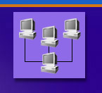


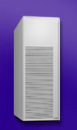
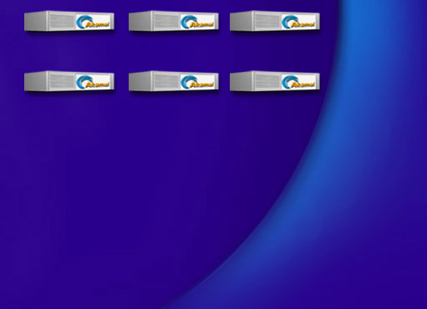


Akamai DNS Resolution
4
xyz.com
.com .net
Root
(Verisign)
5
10.10.123.5
xyz.com’s nameserver
akamai.net
a212.g.akamai.net
8
7
9
6
15.15.125.6
ak.xyz.com
select cluster
10
g.akamai.net
20.20.123.55
11
Akamai High-Level DNS Servers
12
a212.g.akamai.net
30.30.123.5
13
Akamai Low-Level DNS Servers
End User
Local Name Server
select servers within cluster
16
1
3
14
2
Browser’s Cache
15
OS
Notes:
One of many ways—don’t have to do cname but it is easy. Note that usually address is already in local name server and you don’t do all these steps.

Slide 9

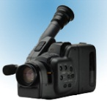
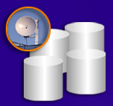




Live Streaming Architecture
x
1 2 3 4
Satellite
Downlink
Satellite
Uplink
1 2 3 4
1 2 3 4
X X X X
Encoding
Entry Point
1 2 3 4
x
1 2 3 4
Top-level reflectors
Regions

Slide 10
SiteShield (www.fbi.gov)
A
K
A
M
A
I
Hacker!
A
K
A
M
A
I
Hacker!
Content
provider’s
website
A
K
A
M
A
I
Hacker!

Slide 11
Part II: Failures
Hardware
Network
Software
Configuration
Misperceptions
Attacks

Slide 12
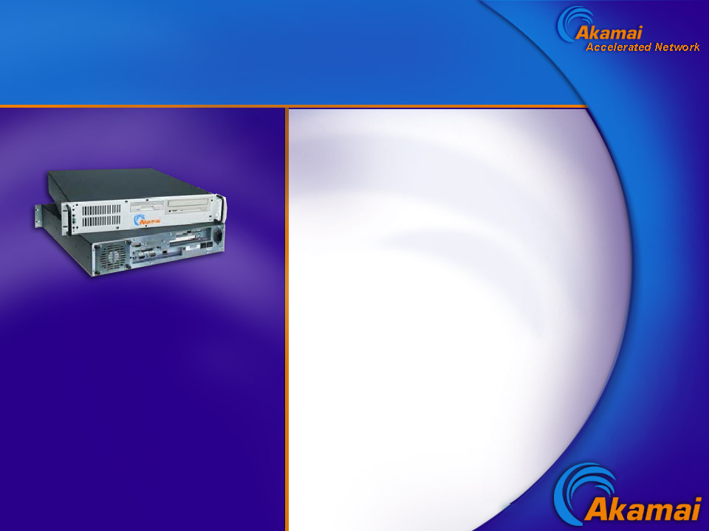
Hardware / Server Failures
Linux boxes with large RAM and disk capacity, Windows servers
Sample Failures:
Memory SIMMS jumping out of their sockets
Network cards screwed down but not in slot
Etc.

Slide 13
Akamai Cluster
Servers pool resources
RAM
Disk
Throughput

Slide 14
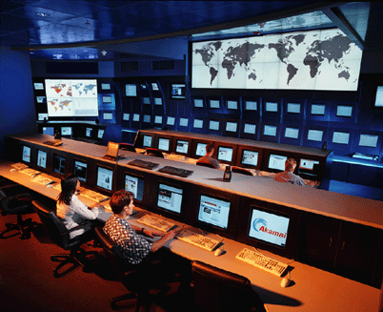

Slide 15
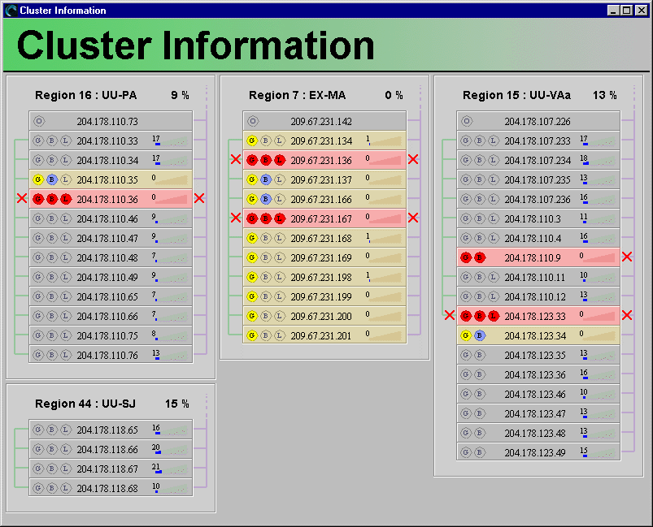
View of Clusters
buddy
suspended
hardware
failure
odd man
out
suspended
datacenter

Slide 16
Network Failures
E.g., congestion at public and private peering points, misconfigured routers, inaccessible networks, etc., etc., etc.

Slide 17
Core Points
X
1
2
3
4
Core point X is the first router at which all paths to nameservers 1, 2, 3, and 4 intersect.
X can be viewed as the straddling the core and the edge of the network.

Slide 18
Core Points
500,000 nameservers
reduced to
90,000 core points
7,000 account for 95% end-user load

Slide 19
Engineering Methodology
C programming language (gcc).
Reliance on open-source code.
Large distributed testing systems.
Burn-in on “invisible” system.
Staged rollout to production.
Backwards compatibility.

Slide 20
Perceived Failures
Examples
Personal firewalls
Reporting tools
Customer-side problems
Third-party measurements

